Slide 1
Scoreboard-Analysis
0128

Slide 2
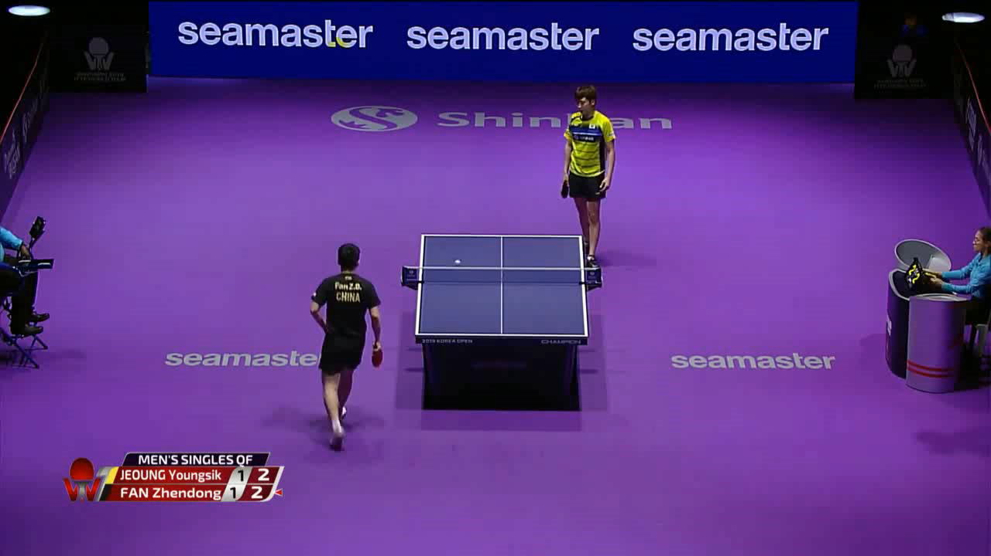
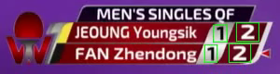
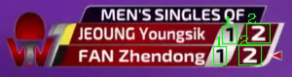
Recap
Scoreboard Detection
Digits Detection
Digits Recognition
Yolo
Yolo
Tesseract OCR
Single Yolo model: classes (0-9)

Slide 3
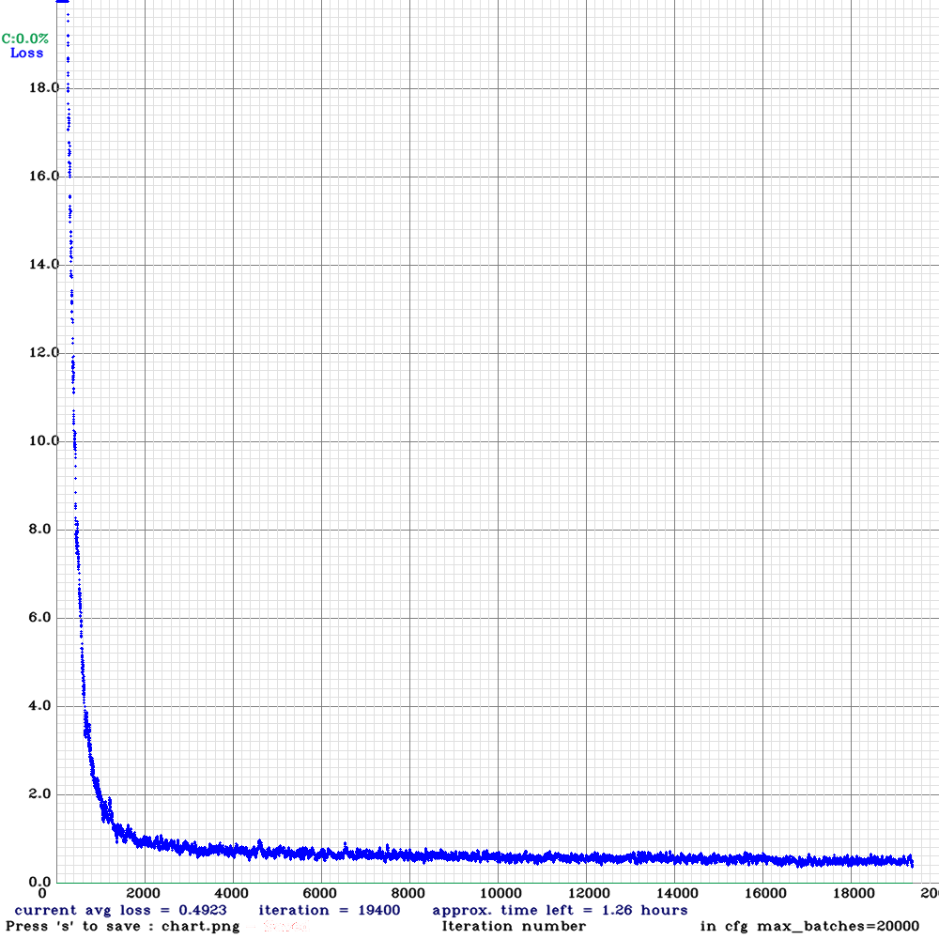
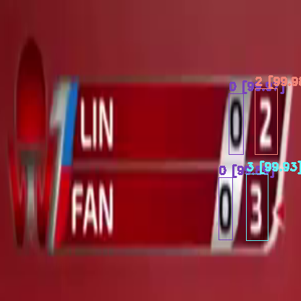
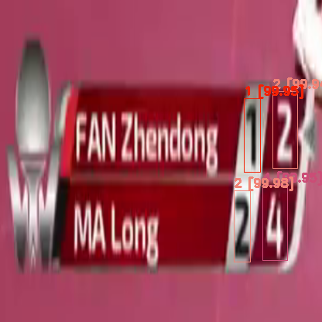
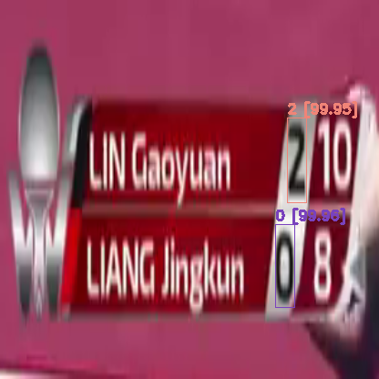
Yolo (0-9)
Notes:
有想過可能是十位數的Data太少
後來增加到一半一半也不行

Slide 4

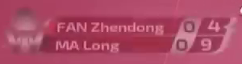

Final Result
加上Scoreboard Detection
Precision Problem
Training Data
每10個frames取1張
 | Video1 | Video2 | Video3 | Video4
Precision | 99.8% | 99.6% | 98.5% | 97%
Recall | 99.7% | 100% | 100% | 100%
Notes:
串上學長的部分

Slide 5
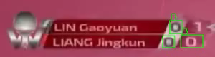
Final Result

